Slide 1
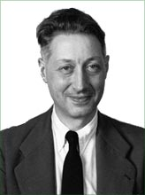
Interpolation and Curve Fitting
Pierre Bézier
De Casteljau construction of Bezier curve
From www.wikipedia.org
Notes:
Pierre Étienne Bézier (September 1, 1910 – November 25, 1999) (pronounced "bay zee ay“)
Received his Ph.D. in mathematics at age 67, (1977)

Slide 2
Bezier Curves and B-Spline Curves
Not really “interpolating” curves as they normally do not pass through data points
Curves stay within the polygon defined by the given points
Local control: effect of changing a knot is limited to a local region in Bezier and b-spline
Global control: moving a knot in a cubic spline affects the whole curve

Slide 3
Global vs. Local Control
Does a small change affect the whole curve or just a small segment?
Local is usually more intuitive and provided by composite curves
Global
Local

Slide 4
Parametric Form
Explicit function
Parametric form
Example: unit circle

Slide 5
Interpolation in Parametric Form
Given n+1 control points,
Compute interpolation functions
j: index for each segment of curve

Slide 6
Composite Segments
Divide a curve into multiple segments
Represent each in a parametric form
Maintain continuity between segments
position
tangent
curvature
P₁(u)
P₂(u)
P₃(u)
P_{n}(u)

Slide 7
Cubic 3D Curves
Three cubic polynomials, one for each coordinate
In matrix notation

Slide 8
Hermite Interpolation
Hermite interpolation requires
values at endpoints
derivatives at endpoints
To create a composite curve, use the end of one as the beginning of the other and share the tangent vector
Needs 4 equations to
solve 4 unknowns
control points/knots

Slide 9
Hermite Curve Formation— consider x coordinate first
Cubic polynomial and its derivative
Given x_{i}, x_{i+1}, x’_{i}, x’_{i+1}, solve for a, b, c, d
4 equations are given for 4 unknowns

Slide 10
Hermite Curve Formation (cont.)
Problem: solve for a, b, c, d
Solution:

Slide 11
Hermite Curve Formation (cont.)
The coefficients can be expressed as linear combination of geometric information

Slide 12
Hermite Curve Formation (cont.)
x component of Hermite curve is then represented as

Slide 13
Hermite Curve Formation (cont.)
Including y and z components
P(u)
u^{T}
M
p

Slide 14
Hermite Interpolation in Matrix Form
ith segment in
composite curves
control points/knots

Slide 15
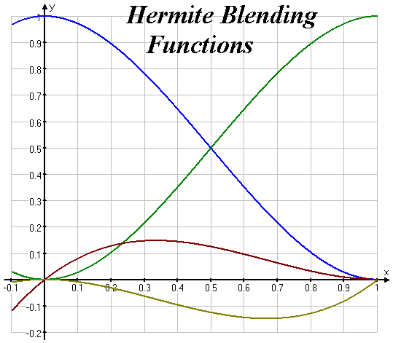
Blending Functions of Hermite Splines
Each cubic Hermite spline is a linear combination of 4 blending functions
geometric information

Slide 16
Bezier Curves
Another variant of the same game
Instead of endpoints and tangents, four control points
points p₀ and p₃ are on the curve
points p₁ and p₂ are off the curve
P(0) = p₀, P(1) = p₃
P’(0) = 3(p₁ - p₀), P’(1) = 3(p₃ - p₂)
p₁
p₃
p₀
p₂

Slide 17
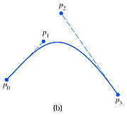
Bezier Curves (cont.)
Variant of the Hermite spline
basis matrix derived from the Hermite basis
Gives more uniform control knobs (series of points) than Hermite
The slope at u = 0 is the slope of the secant line between p₀ and p₁

Slide 18
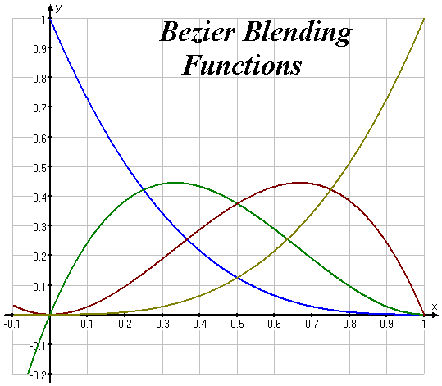
Blending Functions of Bezier Curves
Also known as degree 3 Bernstein polynomials
Weighted sum of Bernstein polynomials (infinite series) converges uniformly to any continuous function on the interval [0,1]

Slide 19
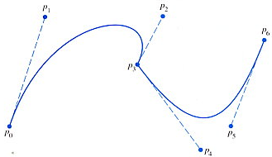
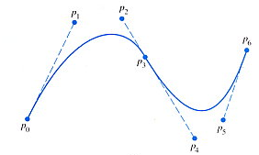
Composing Bezier Curves
Control points at consecutive segments need be collinear to avoid a discontinuity of slope

Slide 20
Interpolation, Continuity, and Local Control
Hermite/Bezier splines
Interpolate control points
Local control
No C2 continuity for cubics
Cubic (Natural) splines
Interpolate control points
No local control - moving one control point affects whole curve
C2 continuity for cubics
Can’t get C2, interpolation and local control with cubics

Slide 21
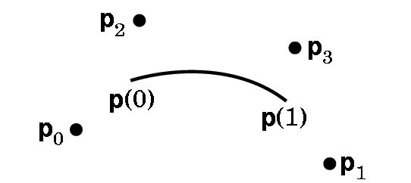
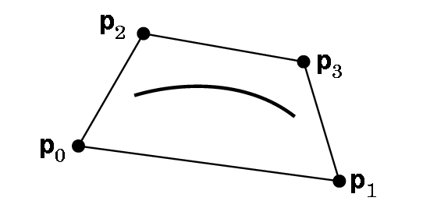
Cubic B-Splines
Basis-spline (B-spline)
Give up interpolation
the curve passes near the control points
best generated with interactive placement (it’s hard to guess where the curve will go)
Curve obeys the convex hull property
C2 continuity and local control are good compensation for loss of interpolation

Slide 22
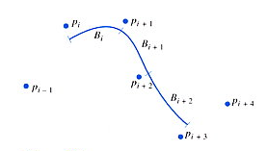
Cubic B-splines (cont.)
Any evaluation of conditions of B_{i}(1) cannot use p_{i+3}, because p_{i+3} does not appear in B_{i}(u)
Evaluation conditions of B_{i+1}(0) cannot use p_{i-1}
Two conditions satisfy this symmetric condition

Slide 23
Solving for B-spline Coefficients
From
We can obtain
We can solve a set of 4 equations for a, b, c, d
Then plug in the followings

Slide 24
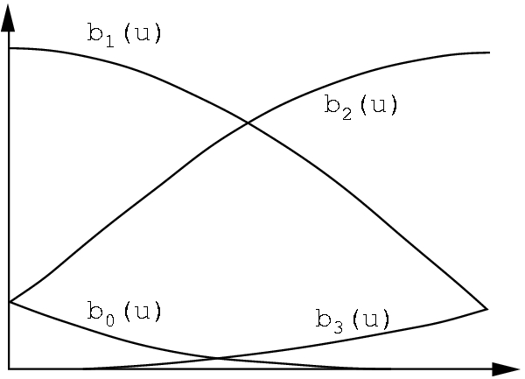
Cubic B-splines in Matrix Form

Slide 25
Blending Functions of Cubic B-Splines
Represent cubic b-spline as
Blending functions

Slide 26
Continuity in Cubic B-splines
Continuity conditions similar to cubic spline
Prove that this condition
is automatically satisfied
if the first two hold!

Slide 27
Composing B-splines
Given points p₀, …, p_{n}, we can construct B-splines B₁ through B_{n-2}
We need additional points outside the domain of the given points to construct B₀ and B_{n-1}
Add fictitious points p₋₂ , p₋₁ , p_{n+1} , p_{n+2}
Set p₋₂ = p₋₁ = p₀ and p_{n+2} = p_{n+1} = p_{n} so that the curve starts and ends at the given extreme points

Slide 28
Comparison of Basic Cubic Splines
Type Control points Continuity Interpolation
Natural n points, shared C2 Y
Hermite 2 points, 2 slopes C1 Y
Bezier 4 points C1 Y
B-Splines 4 points, shared C2 N

Slide 29
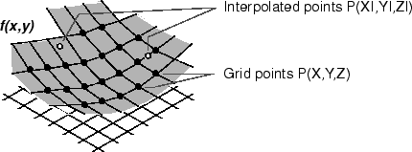
Interpolating on a Surface
Bezier surfaces
B-Spline surfaces

Slide 30
Bicubic Surfaces
To represent surfaces use bicubic functions
x(u,v), y(u,v), z(u,v) are cubic polyomials both in u and v
Let’s consider x(u,v) for now; y(u,v), z(u,v) can be computed similarly
16 terms for combination of powers of u and v
A bicubic surface can be represented by a 4x4 matrix A

Slide 31
Cubic B-Spline Surfaces
Recall B-spline curve:

Slide 32
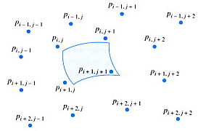
Cubic B-Spline Surfaces
Extend to B-spline Surface

Slide 33
Cubic B-Spline Surfaces
Similarly,
Spline surface is also called a tensor product surface

Slide 34
Bezier Surfaces
Recall Bezier curve:
Similar game, but with different M!

Slide 35
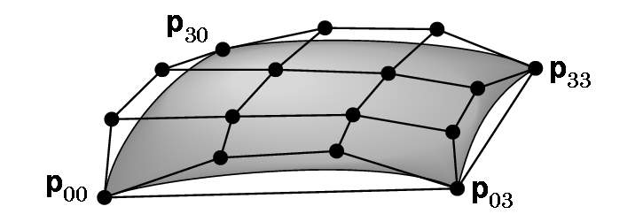
Bezier Surfaces
u
v

